Slide 1

Web Presence Project
Crafting & Compelling Website Analysis, Audit and Recommendations
NAME : Pushparaj.M
BATCH CODE : BADM-WD-T-B9

Slide 2

WIPRO
About The Company
Wipro Limited is an Indian multinational technology company headquartered in Bangalore, Karnataka. It was originally incorporated as Western India Vegetable Products Limited in 1945 by MH Hasham Premji. Over the years, Wipro has evolved significantly and is now one of the leading global information technology, consulting, and business process services companies

Slide 3
Product and Service Description
Web Design and Development: Creating visually appealing and functional websites tailored to client needs.
E-commerce Solutions: Developing robust e-commerce platforms with features like payment gateways, inventory management, and customer support.
Digital Marketing: Implementing SEO, content marketing, and social media strategies to enhance online presence and drive traffic.
UX/UI Design: Designing user-friendly interfaces to improve user experience and engagement.
Cloud Services: Leveraging cloud technologies to ensure scalability, security, and performance of web applications.
Application Development: Building custom applications using various technologies such as HTML5, CSS3, JavaScript, PHP, and CMS platforms like WordPress and Magento

Slide 4
Website Platform Identification
Wipro's website is developed using a variety of modern web development tools and technologies to ensure a robust, scalable, and user-friendly experience.
HTML5 & CSS3: For structuring and styling the website.
JavaScript & jQuery: For adding interactivity and dynamic content.
PHP, Python, or Ruby on Rails: For server-side scripting and backend development.
Content Management Systems (CMS): Platforms like WordPress or Drupal might be used for easier content management.

Slide 5
Frontend Frameworks: Libraries like React, Angular, or for building modern user interfaces.
Version Control Systems: Tools like Git for managing code changes and collaboration.
Cloud Services: AWS, Azure, or Google Cloud for hosting and scalability.
SEO Tools: To optimize the website for search engines.
Wipro also offers its own Accelerated Development Toolkit (ADT), which helps in building scalable and robust applications. This toolkit supports open-source platforms and aims to reduce development efforts by up to 30%

Slide 6

Responsive Design Testing
Device/Screen Size | Result | Notes
Desktop (1920x1080) | Perfect layout | All elements are correctly aligned, and images are clear
Laptop (1366x768) | Good layout, minor adjustments needed | Some spacing issues with images
Tablet (768x1024) | Good, but some UI elements overlap | Navigation menu needs optimization for touch
Mobile (375x667) | Mostly good, but text is too small | Adjust font size and ensure buttons are easily clickable
Mobile (320x480) | Layout needs improvement | Hamburger menu not functioning properly, images overlapping

Slide 7

Website Mistakes Identification
Optimize Images
Ensure that images are properly optimized for web use. Use tools like TinyPNG or ImageOptim to reduce file sizes without losing quality.
Choose the Right Format
Resize Images
Compress Images

Slide 8
Use Responsive Frameworks
Implement responsive design frameworks like Bootstrap or Foundation to ensure consistency across devices.
Framework | Key Features | Pros | Cons
Bootstrap | Grid system, pre-styled components | Easy to use, lots of documentation | Can look similar to other sites
Foundation | Flexible grid, mobile-first design | Flexible, semantic code | Steeper learning curve
Bulma | Flexbox-based, clean syntax | Lightweight, easy to use | Smaller community
Improve Load Times
Use techniques like lazy loading for images and asynchronous loading for scripts to improve page load times.

Slide 9



Simplify Navigation
Ensure that the navigation menu is easy to use on both desktop and mobile devices. Consider using a hamburger menu for smaller screens.
Clear and Consistent Menu Structure
Logical Grouping
Visible Search Bar
Mobile-Friendly Navigation
Highlight Important Links
Collect User Feedback
Gather feedback from users to identify pain points and areas for improvement.

Slide 10

Website Best Practices List
High-Quality Content
Provide high-quality, relevant content that adds value
to visitors.
Regularly update the content to keep it fresh
and engaging.
User-Friendly Forms
Design forms to be easy to fill out and submit.
Use clear instructions and validation to prevent errors.
Consistent Branding
Maintain consistent branding across all pages, including logos, colors, and fonts.
Ensure the design aligns with Wipro's brand identity.

Slide 11

Analytics and Feedback
Use tools like Google Analytics to track user behavior and identify areas for improvement.
Collect user feedback to understand their needs and preferences.
SEO Optimization
Use relevant keywords and meta tags to improve
search engine rankings.
Ensure the website is indexed correctly by
search engines.
Security
Implement SSL certificates to ensure secure
connections.
Regularly update software and plugins to protect against vulnerabilities.

Slide 12
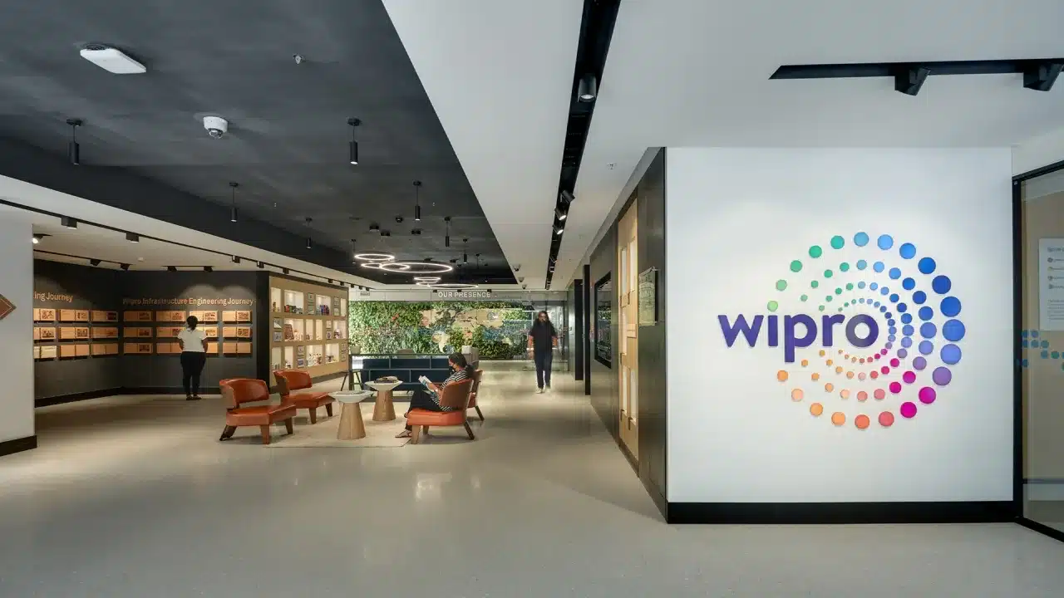
Landing Page Design
Wipro Healthcare
Design Feature
Home page of Healthcare website
What kind of services they do
Success stories of Wipro healthcare
More about us
Landing Page Design :https://http-wipro.my.canva.site/wipro

Slide 13
Conclusion
This project has positioned Wipro as a leader in digital innovation, providing a user-friendly, secure, and accessible online platform that effectively communicates the company's values and services to a global audience. The continuous focus on optimization and user feedback will ensure Wipro's web presence remains robust and future-proof.

